Slide 1
Machine Learning Models: a hands-on experience
UniCredit Quant Community
Gabriele Bonomi Boseggia, Fabio Colombo, Luca Mammi
Milan, May 8th, 2018

Slide 2


What is Machine Learning
Machine Learning is a set of tools, models and algorithms that lend themselves to prediction
INFORMATION
DATA!
AUTOMATION
LOTS OF
DATA!

Slide 3
What is Machine Learning
Machine Learning is a set of tools, models and algorithms that lend themselves to prediction
Training Data
Machine Learning Algorithm
New Data
Classifier
Prediction

Slide 4
You must know your data

Slide 5
Types of Machine Learning – by how they work
Labelled data
Unlabelled data
Lots of
labelled data
Supervised learning
Unsupervised learning
Reinforcement learning
Classification
Clustering
Regression
Dimensionality reduction
…but is this the most
effective taxonomy?

Slide 6
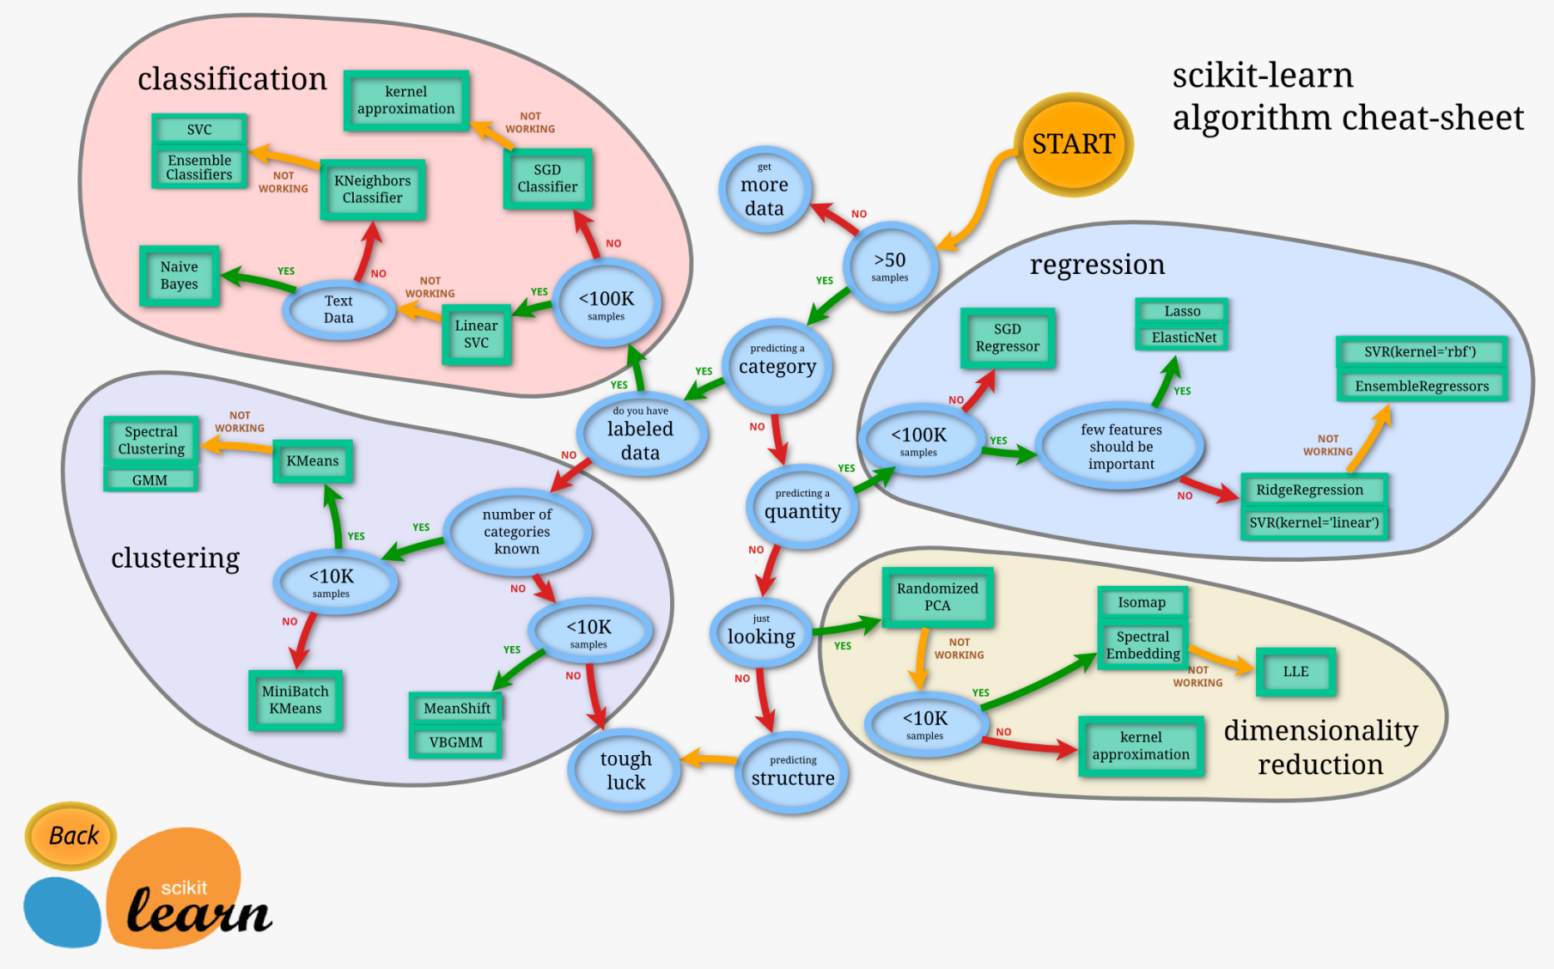
Types of Machine Learning – by what we need them to do

